Slide 1
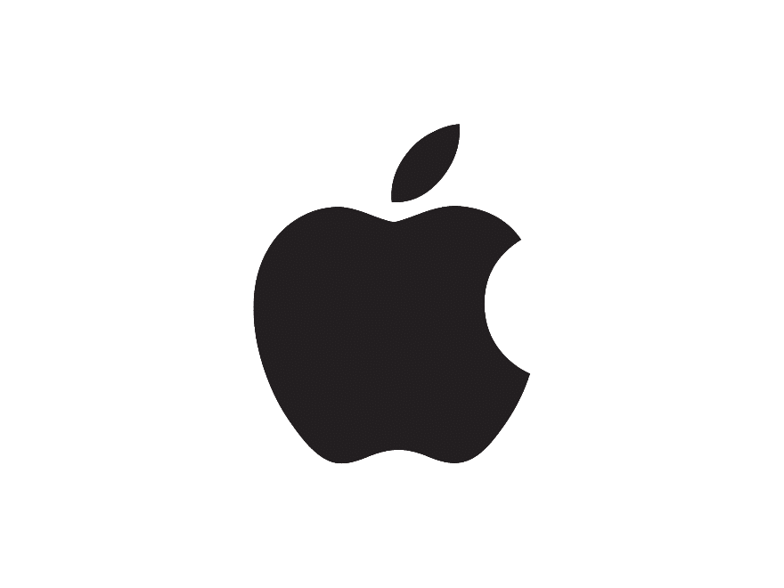

Apple’s Performance in the German market.
Brandon Sperry
International Business Management
March 12, 2023
This Photo by Unknown Author is licensed under CC BY-SA

Slide 2

Introduction
Apple was started April 1, 1976 in Los Altos, CA.
Steve Jobs and Steve Woznika where the creators of the company.
The Apple 1 was built in the garage of Steve Job’s parents’.
The Apple 2 introduced color graphics to the PC world.
Apple in the first company to have a value of a 3 Trillion dollars market value.
Before this first store was opened Apple has been working in Germany for 40 years.
Worldwide Apple has over 522 (273 in the USA and 249 overseas)
Apple is in 25 countries

Slide 3
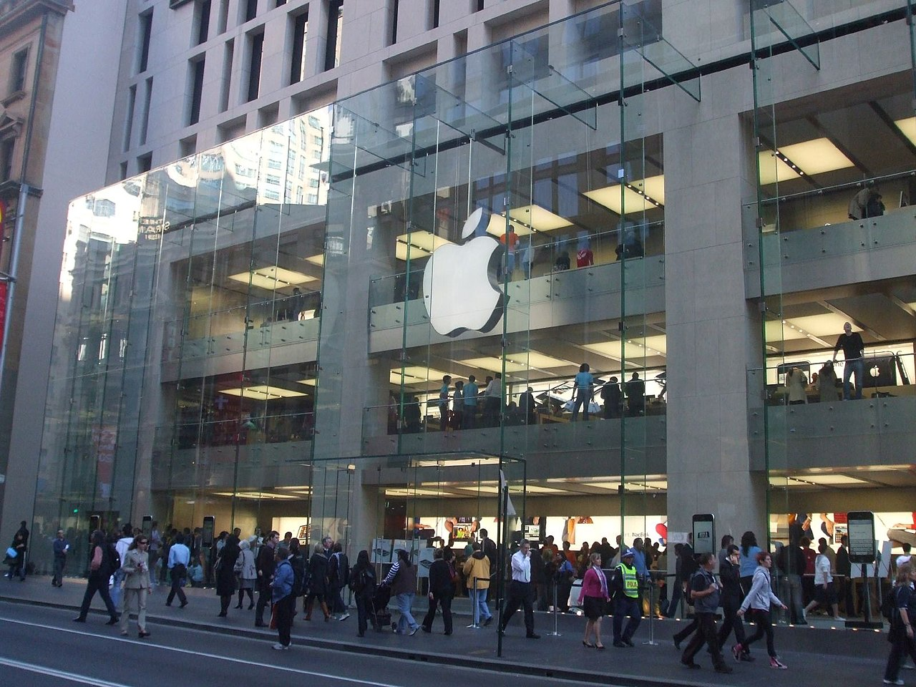
Apple in the German Market
Apple has been working in German since 1981.
Apple built it’s first store in 2013 in Berlin.
Apple has 16 locations in Germany.
Apple is building a new facility in Munich to focus on 5G and future wireless technologies.
Apple iPhone market shares are 37.67%
In the phone market Apple has a strong competitor in Android.
This Photo by Unknown Author is licensed under CC BY-SA

Slide 4
Internationalization Levels
As of October 2022 Apple owns 115 companies.
Apple is in 25 countries
Apple does not focus on any specific geographic. Apple likes to be able to reach everyone. Apple would like to have their products in everyone’s hands. To Apple industry does not matter to them.

Slide 5
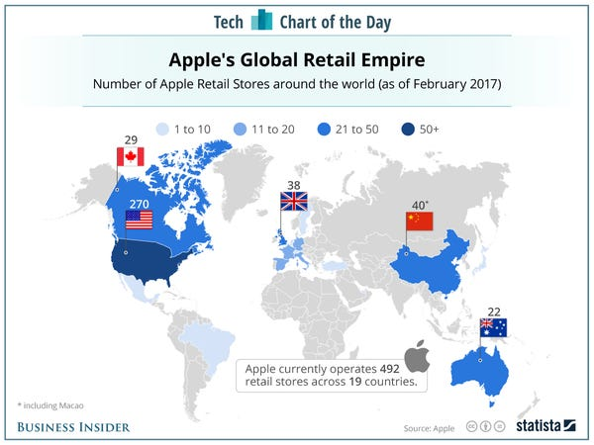

Slide 6
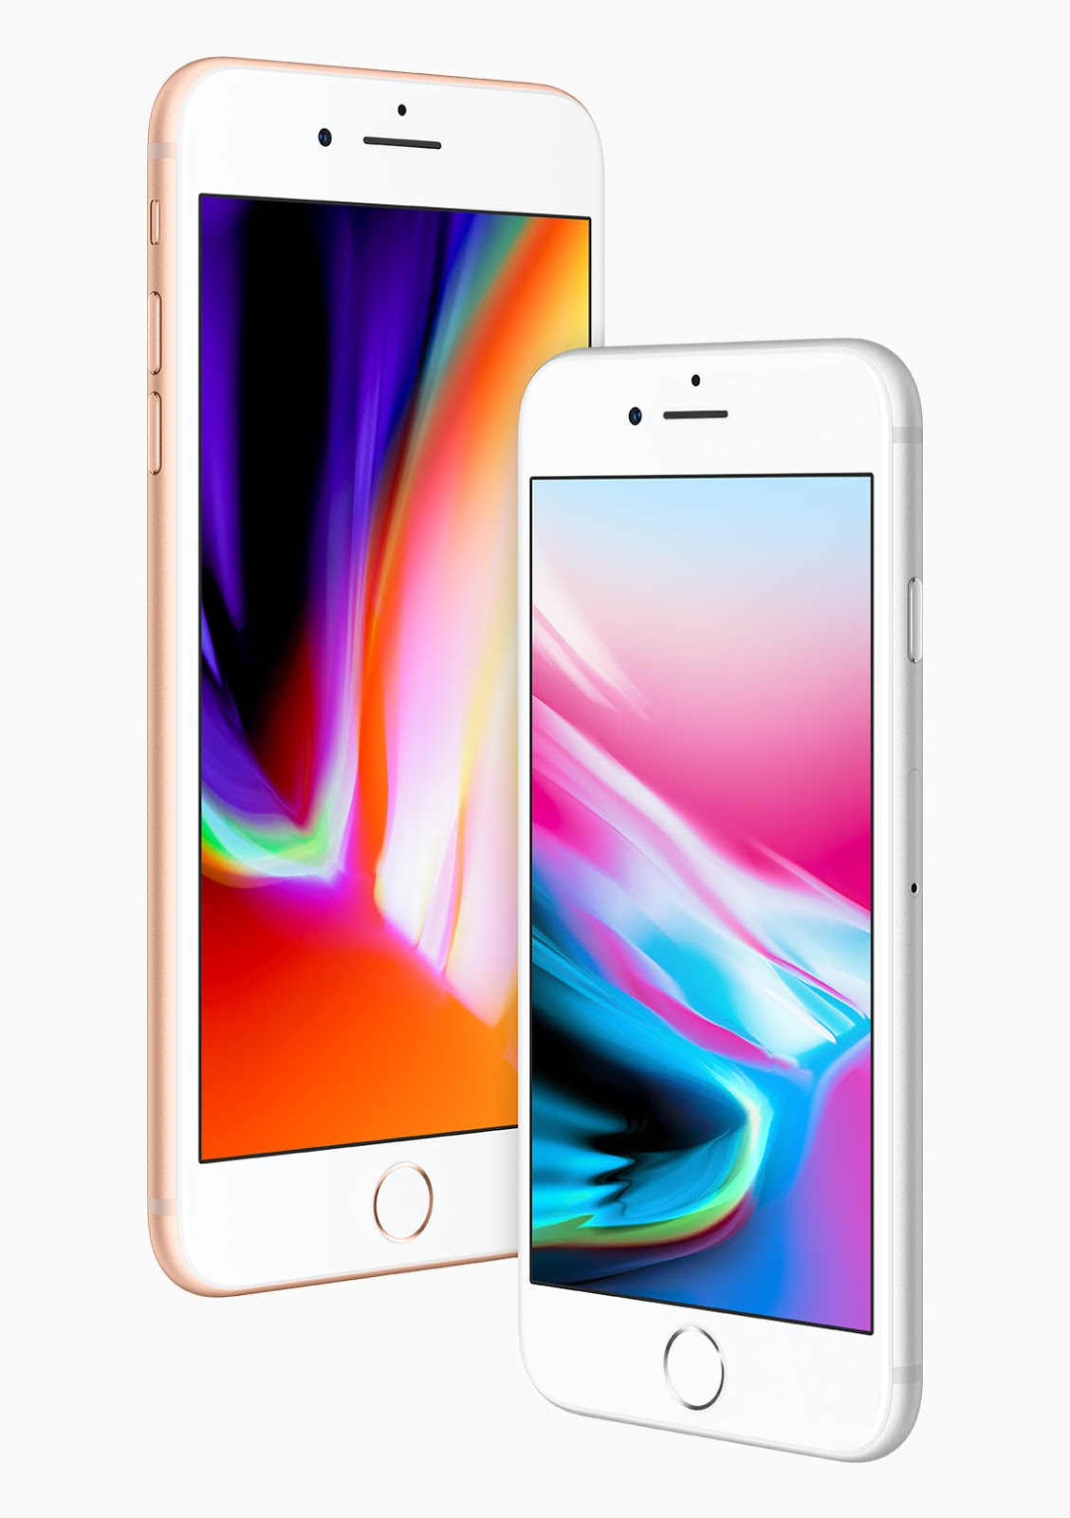
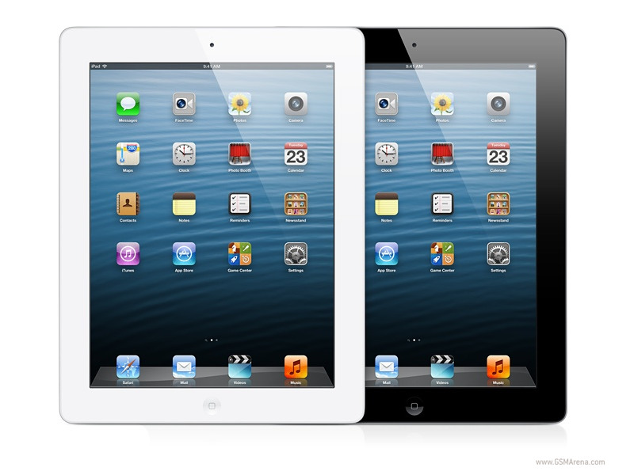
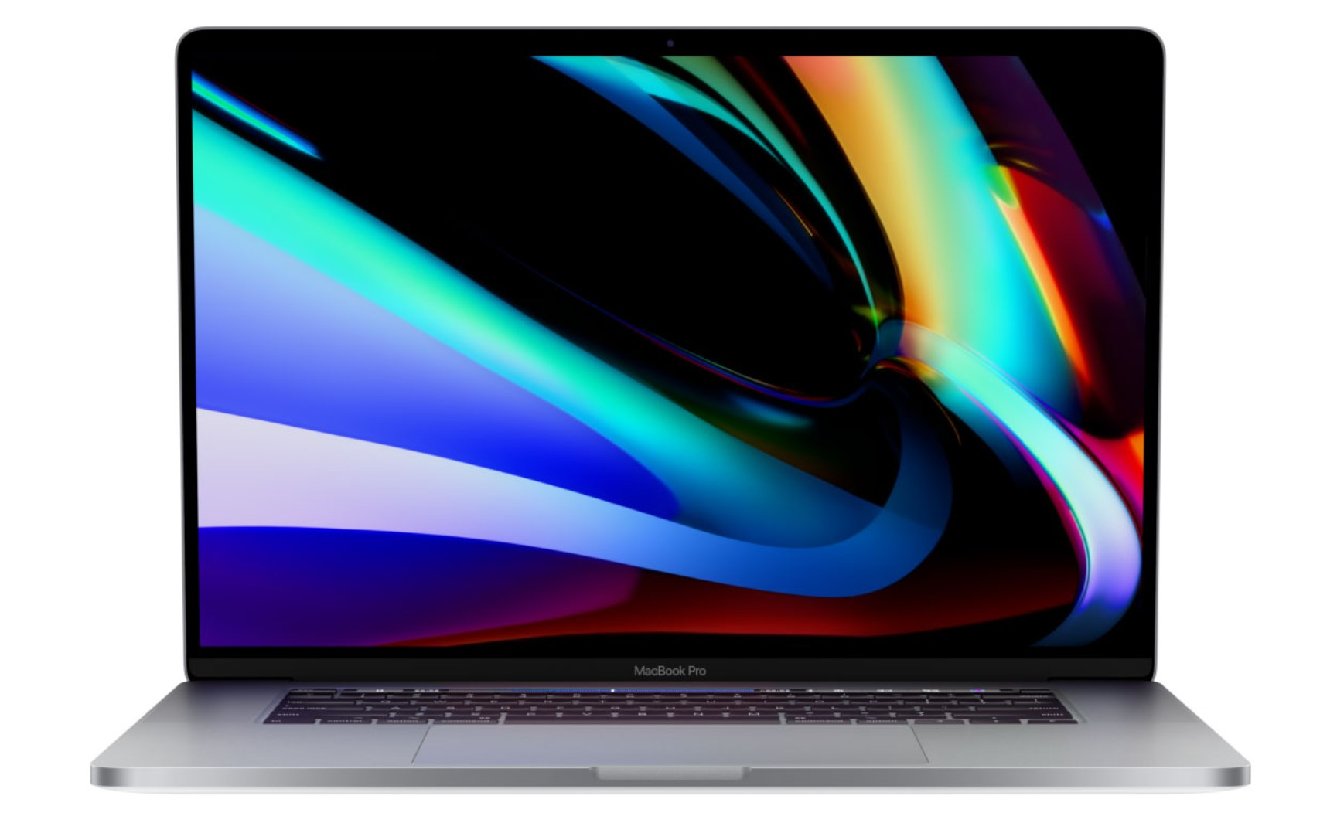
FDI rationale and performance
The reason why Apple entered into the German market is because of resources in their
hands. Apple wanted to be a competitor for other companies with similar products.
Apple’s revenue in the German market is lower than the USA. Apple’s main market
that they want to focus on is the US market.
This Photo by Unknown Author is licensed under CC BY
This Photo by Unknown Author is licensed under CC BY-NC
This Photo by Unknown Author is licensed under CC BY

Slide 7
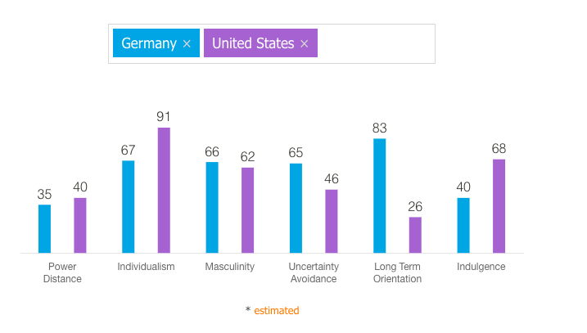
Values and norms
The cultural distance between the USA and Germany that exist are.
Apple is seen as an American company who’s main focus in only on America.

Slide 8
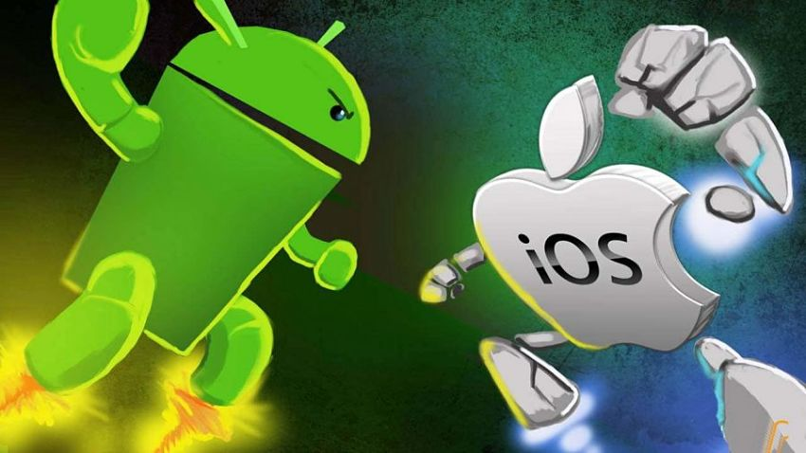
Values and norms continued
Apple face heavy competition with it’s competitors in the phone market in Germany. Android OS is beating Apple OS by a little over 23%. This mean that Apple is having a tough time getting the German market to see that their product is better or they are not spending enough time promoting themselves in the country.
This Photo by Unknown Author is licensed under CC BY-SA-NC

Slide 9
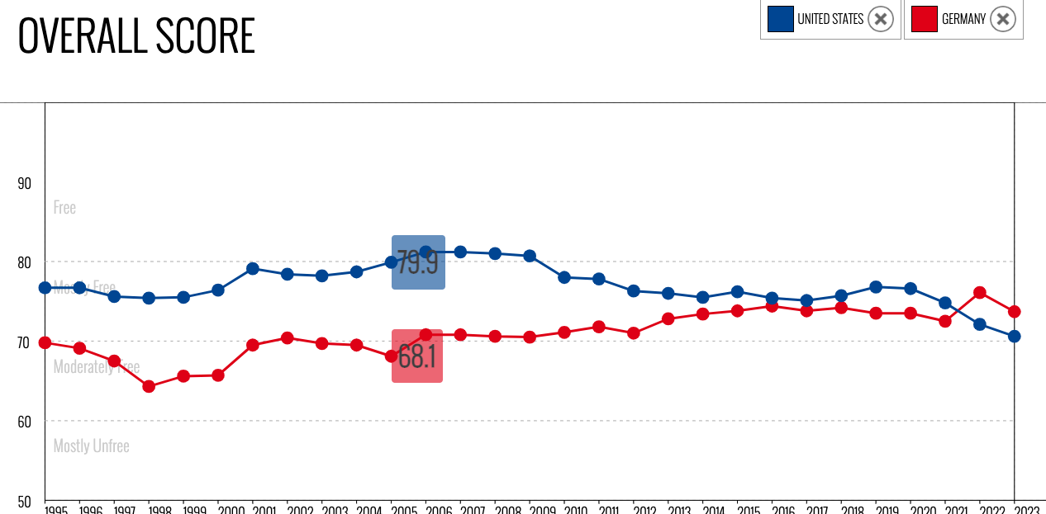
Institutional factors
The is a very low institutional distance between the USA and Germany.
This is because both countries are working on to make their own country a better place.

Slide 10
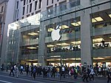

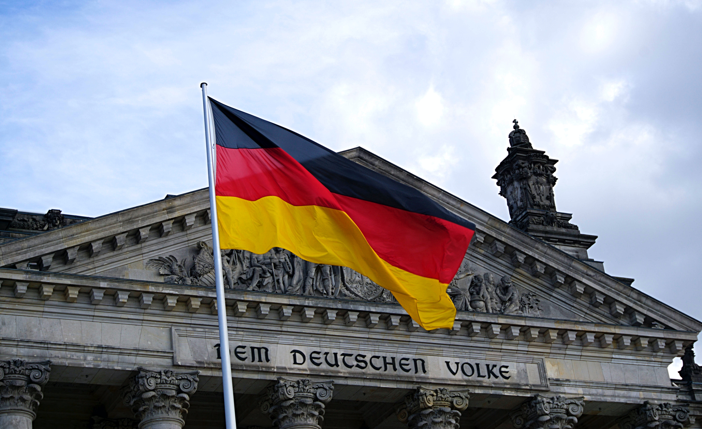
Institutional factors continued
For Apple products to do better in Germany the company needs to switch it focus to having a bigger foot print in their market. They need to have more people going out their asking the people of the country what would they like in a new Apple device
One of the main distances that Apple is facing in Germany is that more Germans prefer an Android phone over that of an iPhone. Due to pricing. Here in America we buy a phone with a service attached to it. In Germany they buy a phone and the service separate.
This Photo by Unknown Author is licensed under CC BY-SA

Slide 11

References
Log in: S&P Capital IQ. Log In | S&P Capital IQ. (n.d.). Retrieved March 10, 2023, from https://www.capitaliq.com/ciqdotnet/company.aspx?leftlink=true&companyId=99942756
Research guides: This Month in business history: The founding of Apple Computers, inc.. The Founding of Apple Computers, Inc. - This Month in Business History - Research Guides at Library of Congress. (n.d.). Retrieved March 10, 2023, from https://guides.loc.gov/this-month-in-business-history/april/apple-computers-founded
Apple Rosenthaler Straße opens Thursday, December 2, in Berlin. Apple Newsroom. (2023, February 27). Retrieved March 10, 2023, from https://www.apple.com/newsroom/2021/12/apple-rosenthaler-strasse-opens-thursday-december-2-in-berlin/#:~:text=Apple%20opened%20its%20first%20store,%2C%20Apple%20Kurf%C3%BCrstendamm%2C%20in%202013.
Apple retail store - store list. Apple. (n.d.). Retrieved March 10, 2023, from https://www.apple.com/retail/storelist/
Smith, Z. S. (2022, October 12). Apple becomes 1st company worth $3 trillion-greater than the GDP of the UK. Forbes. Retrieved March 10, 2023, from https://www.forbes.com/sites/zacharysmith/2022/01/03/apple-becomes-1st-company-worth-3-trillion-greater-than-the-gdp-of-the-uk/?sh=35d3618c5603

Slide 12
References continued
Gren, C. (2022, October 11). A happy family: The top companies owned by Apple. Industry Leaders Magazine. Retrieved March 10, 2023, from https://www.industryleadersmagazine.com/a-happy-family-the-top-companies-owned-by-apple/#:~:text=Often%20Apple%20integrates%20the%20products,Apple%20owns%20approximately%20115%20companies.
Dunn, J. (n.d.). Here's how Apple's retail business spreads across the world. Business Insider. Retrieved March 10, 2023, from https://www.businessinsider.com/apple-stores-how-many-around-world-chart-2017-2
Country comparison. Hofstede Insights. (2023, January 27). Retrieved March 10, 2023, from https://www.hofstede-insights.com/country-comparison/germany,the-usa/
Mobile Operating System Market Share Germany. StatCounter Global Stats. (n.d.). Retrieved March 10, 2023, from https://gs.statcounter.com/os-market-share/mobile/germany
Index of economic freedom. (n.d.). Retrieved March 10, 2023, from https://www.heritage.org/index/visualize?cnts=germany%7Cunitedstates&src=country

